Slide 1
SWE 4101
Lec – 7
Release & maintenance
All contents are based on textbooks, research articles, online resources, and personal experience.

Slide 2
What is a SW Release
A SW release is the launch of a new SW or a combination of features that will provide value to customers or users.
For your customers, it's a promise of new value they can look forward to embedding in their everyday work and activities.
For your internal teams, a release helps them plan their work and when they'll be needed to launch great products.
A release is not just the act of providing access to new technical functionality. Instead, think of a release as the date when the company is ready to deliver a new customer experience and support every customer interaction point associated with it.

Slide 3
What is Release Management?
Release Management is the process of planning, building, testing and deploying hardware and software and the version control and storage of software.
Its purpose is to ensure that a consistent method of deployment is followed.
It reduces the likelihood of incidents as a result of rollouts and ensures that only tested and accepted versions of hardware and software are installed at any time.

Slide 4
The Objectives Release Management
Deploy application changes into production without disrupting the business.
To be classified as successful, the release must meet the following objectives:
    (a) Deployed on time
    (b) Deployed on budget
    (c) Have no or negligible unwanted impact on existing customers
    (d) Satisfy the requirements of new customers, competitive pressure and/ or technological advances.

Slide 5
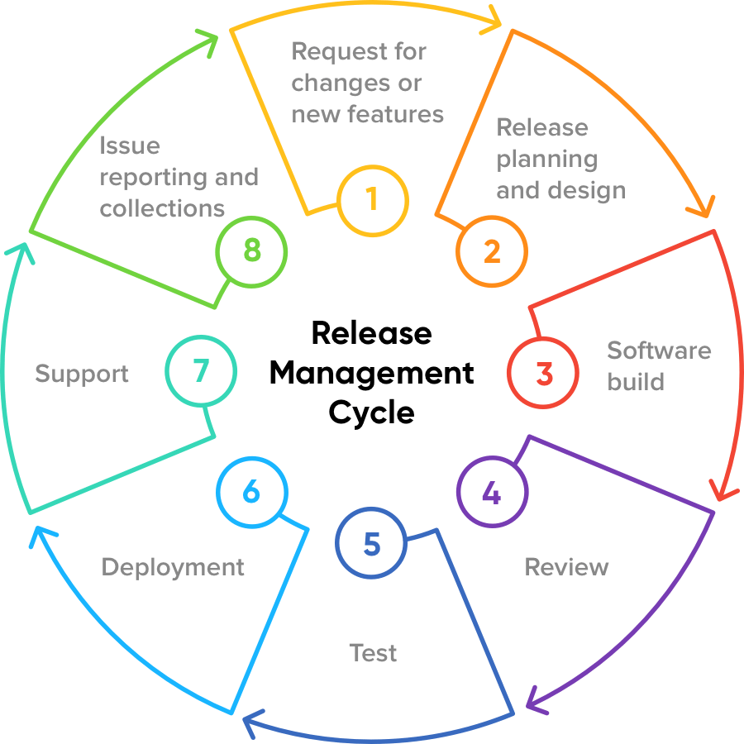
Release Management Cycle

Slide 6
The Process
First, someone decides changes need to be made to an application. This need is documented and results in a release.
A developer sees the changes to be made and edits the source code of the application to remedy the issue(s).
Once ready, the code is aggregated and compiled into a build.
The build is deployed in a QA environment to be thoroughly tested.
The build is tested. The testing can be something as simple as seeing if the page loads, called a “smoke test,” or it can be in depth and executed by a tester.
After initial testing, if the build is up to snuff, it enters another non-production-testing environment (Staging). If there are bugs or it doesn’t meet the criteria, it will be retested until it can be considered ready.
Once an application is ready, it is deployed, or “released,” into production.

Slide 7
The Process – Plan Release
The planning stage may be the most time intensive as this is where your entire release is structured from start to finish.
During this stage, create a workflow that both your team and key stakeholders can refer to throughout a release.
The later in the development cycle an error is found, the more expensive it is to fix.
The workflow should explain at a glance how the whole release is staged and how each team member plays a part. Your release plan should include:
  Timelines
  Delivery dates
  Requirements
  The overall scope of the project

Slide 8
The Process – Build Release
With the release plan finalized, you can start designing and building the product for release.
This is the actual “development” of the product based on the requirements outlined in the release plan.
Once all the issues that may have come up are addressed, it’s time to subject the build to real-world scenario testing.
This could take several iterations and allows the team to identify any bugs or issues that may arise in a real-world environment.
As issues are identified, the build is sent back for development at stage two. In other words, within the iterative release management process, the work may flow from stage two to stage three and back again until the release is approved.

Slide 9
The Process – UAT
Already Discussed

Slide 10
The Process – Prepare Release
This step is to put the finishing touches on the product, taking into account everything that was learned in UAT.
Release preparation also includes a final quality review by the QA team.
During the review, the QA team will conduct final checks to ensure the build meets the minimum acceptable standards and business requirements outlined in the release plan.
Once the review is completed, the functional team will validate the findings and finalize the release for deployment.
Before the build can deploy into a live environment, it must be approved by the product owner.

Slide 11
The Process – Deploy Release
It’s time to release your product into the wilds of the live production environment.
Besides simply sending the build out into production, the deployment stage also includes messaging and education on the product to both the end user and your company at large.
For instance, users should be notified of changes with the release and how to operate within the new features. Depending on how significant the changes were, you may need to provide robust and ongoing training to get everyone up to speed.
Finally, during the deployment stage, the development team should meet to assess the release’s performance and discuss how the deployment went.
If there are any lingering issues, those should be identified and documented for the team to address in the next iteration..

Slide 12
Release Management Best Practices
some natural best practices:
Automate as much as possible, both on the devops and testing side. Automation cuts down on the human cost, allowing more rapid iteration, and reduces the chance for false positives and negatives (computers tend to make less mistakes than humans).
Have clear requirements, and from these make testable acceptance criteria. There should be no ambiguity about whether the software is ready to ship.
Minimize user impact of a release by minimizing or eliminating downtime and testing for regressions before release.
Make things immutable wherever possible. Instead of modifying the configuration of an existing machine, deploy a complete image that contains all of the configuration. This avoids bugs from appearing due to an unexpected series of actions.

Slide 13
Release Note
Release notes is a document, which is released as part of the final build that contains new enhancements that went in as part of that release and also the known issues of that build.
Release Notes Format:
  Header - Name of the document, which carries product name, release number, release date, release note date and version.
  Overview - An overview of the product and changes to the recent software version.
  Purpose - An overview of the purpose of the release notes which lists the new feature, enhancements and defects of the current build.
  Issue Summary - Provides description about the defect.
  End-User Impact - Provides information about the end-users impact due to the defect.
  Contact - Support contact information.

Slide 14
Release Versioning
Versions and Releases are denoted using a quadruplet of integers to indicate Major, Minor, and Revision (Rev); Build numbers are for internal tracking and verification of the software build process and will not be visible to customers are part of the software version number.
          <MAJOR>. <MINOR>. <REVISION>.<BUILD>
          Example: “2.4.7.1333”
      The version above is reference as version 2.4.7, Where: Major release is 2, Minor release is 4, Rev release is 7 and Build is not used except for internal tracking/deployments

Slide 15
Major Release
A Major Release is a full product release of the software.
It generally contains new customer-facing functionality and represents a significant change to the code base comprising the software product or family of products, or is used to represent a significant marketing change or direction in the product.
Scope:
Any change to the code base that prevents backwards compatibility (e.g. Addition or Removal of features, changes in the DB schema or API commands).
Any new functionality that is customer facing.
Any large marketing push that accompanies the product and redirects the product.
Frequency:
Market driven
Audience:
New customers.
Existing customers with qualifying contracts
Existing customers desiring to upgrade to the new feature set

Slide 16
Minor Release
A Minor Release of the software may be comprised a rollup of several branched releases, enhancements/extensions to existing features or interfaces driven by internal or external requirements.
external requirements could be driven by enhancements to meet new sales area , internal requirements could be enhancements aligned to a new marketing push.
Scope:
Minor enhancements and features that do not affect compatibility with its associated major or current minor releases. New features or functionality that does minimally effect the interfaces
Addition of new features or functions to meet a new sales area that doesn’t affect existing customers of the release. To accompany or communicate a new marketing initiative.
Error corrections and maintenance.
A rollup of branched releases.
Frequency:
Enhancement or Market driven
Audience:
New customers.
Existing customers with qualifying contracts
Existing customers desiring to upgrade to the new feature set

Slide 17
Revision Release
A Revision (Rev) is a build of all or part of the software that is initially distributed to an internal audience, specifically software quality assurance, for software validation.
If the Rev is successfully validated and accepted, this version is “released” to manufacturing. If defects are found that prevent the Rev from successfully being validated and prevent the release to manufacturing, the Rev value will be incremented prior to the next validation cycle.
Scope: •
Releasing build to SQA for validation
Frequency:
As necessary, but typically every 1 to 3 months.
Audience:
Existing customers with qualifying contracts.

Slide 18
Build Release
A Build Release is a build of all or part of the software distributed to an internal audience, these releases should have targeted feature enhancements and issue resolution documented to allow testing in the targeted/specific areas where the changes were implemented.
Scope: • Resolves a particular defect, typically of a critical Severity level with no viable workaround.
Frequency: •
Extensively used during internal development.
Audience:
Internal developers
Internal verification

Slide 19
Semantic Versioning 2.0.0
MAJOR.MINOR.PATCH
Check below link for more information.
https://semver.org/

Slide 20
Continuous Integration (CI)
Continuous Integration (CI) is a development practice that requires developers to integrate code into a shared repository several times a day.
Each check-in is then verified by an automated build, allowing teams to detect problems early.
By integrating regularly, you can detect errors quickly, and locate them more easily.
“Continuous Integration doesn’t get rid of bugs, but it does make them dramatically easier to find and remove.”
— Martin Fowler, Chief Scientist, ThoughtWorks

Slide 21
Continuous Integration (CI)
Continuous Integration brings multiple benefits to your organization:
Say goodbye to long and tense integrations
Increase visibility enabling greater communication
Catch issues early and fix them regularly
Spend less time debugging and more time adding features
Build a solid foundation
Stop waiting to find out if your code’s going to work
Reduce integration problems allowing you to deliver software more rapidly

Slide 22
Continuous Integration (CI)
How to achieve:
Developers check out code into their private workspaces
When done, commit the changes to the repository
The CI server monitors the repository and checks out changes when they occur
The CI server builds the system and runs unit and integration tests
The CI server releases deployable artefacts for testing
The CI server assigns a build label to the version of the code it just built
The CI server informs the team of the successful build
If the build or tests fail, the CI server alerts the team
The team fixes the issue at the earliest opportunity
Continue to continually integrate and test throughout the project

Slide 23
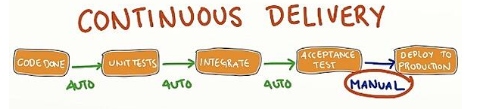
Continuous Deployment (CD)
Continuous delivery is a software development practice where code changes are automatically prepared for a release to production.
CD expands upon CI by deploying all code changes to a testing environment and/or a production environment after the build stage.
Continuous delivery automates the entire software release process. Every revision that is committed triggers an automated flow that builds, tests, and then stages the update.

Slide 24
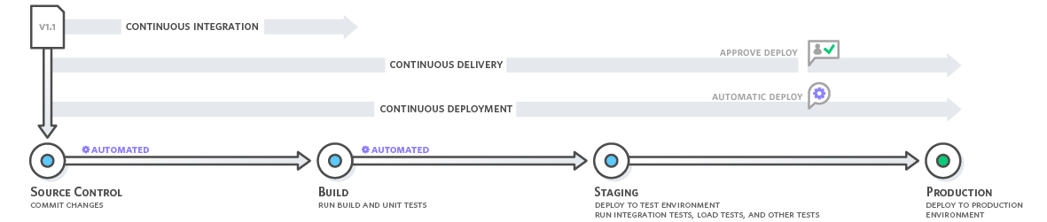
Continuous Delivery vs. Continuous Deployment
With continuous delivery, every code change is built, tested, and then pushed to a non-production testing or staging environment.
There can be multiple, parallel test stages before a production deployment.
The difference between continuous delivery and continuous deployment is the presence of a manual approval to update to production. With continuous deployment, production happens automatically without explicit approval.

Slide 25
SW Maintenance…

Slide 26
What is a SW Maintenance
Not just "fixing mistakes"
Any post-delivery modification to an existing system
May be corrective, adaptive, perfective, or preventative
IEEE Definition:
Maintenance is
  The process of modifying a software system or component after delivery to correct faults, improve performance or other attributes, or adapt to a changed environment.

Slide 27

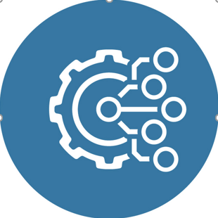
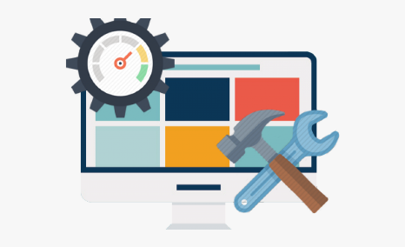

Types of maintenance
Corrective maintenance
Adaptive maintenance
Perfective maintenance
Preventative maintenance
This includes modifications and updations done in order to correct or fix problems, which are either discovered by user or concluded by user error reports.
This includes modifications and updations applied to keep the software product up-to date and tuned to the ever changing world of technology and business environment.
This includes modifications and updates done in order to keep the software usable over long period of time. It includes new features, new user requirements for refining the software and improve its reliability and performance.
This includes modifications and updations to prevent future problems of the software. It aims to attend problems, which are not significant at this moment but may cause serious issues in future.

Slide 28
Corrective Maintenance
The purpose of corrective maintenance is to restore broken down systems.
Corrective maintenance tasks can be both planned and unplanned.
There are three situations when corrective maintenance occurs:
  When an issue is detected through condition monitoring
  When a routine inspection uncovers a potential fault
  When a piece of equipment breaks down

Slide 29
Adaptive Maintenance
The tech environment is constantly changing. New knowledge, hardware, and cybersecurity threats mean that software quickly becomes outdated. Adaptive software maintenance addresses this issue.
Adaptive changes focus on the infrastructure of the software. They’re made in response to new operating systems, new hardware, and new platforms, to keep the program compatible.
Adaptive software changes tend to be low impact for users as they deal with the internal workings of the software. (Making sure it can integrate with new tech.) Users may notice a small improvement in speed or scalability but are otherwise unaffected.
In fact, users are more likely to notice when adaptive maintenance isn’t completed. For example, it would mean their software stops working on their up-to-date devices.

Slide 30
Perfective Maintenance
Perfective software maintenance addresses the functionality and usability of the software. Perfective maintenance involves changing existing product functionality by refining, deleting, or adding new features.
Any user interface tweaks, redesigns, or in-app user journey changes fall under the perfective maintenance category, too.
Perfective changes are highly noticeable. Users won’t notice a bit of refactored back-end code, but they’ll notice any chops and changes visible up-front.
So, managing perfective changes means communicating with your users to mitigate any potential negative sentiment.
Change is necessary: but make sure you manage it effectively.

Slide 31
Preventive Maintenance
Preventive maintenance refers to software changes carried out to futureproof your product. So, software maintenance changes are preventive when they prepare for any potential changes ahead.
This includes making your code easier to scale or maintain and managing your legacy content. It also covers finding and fixing latent faults in your product, before they evolve into operational faults.
Preventive software maintenance, then, tends to be behind the scenes. Think tidying and preparation, rather than headline changes.
Your users are unlikely to notice preventive software changes – but they still have a positive effect later. This is because preventive maintenance can mean the smoother implementation of bigger changes later down the line. (As well as ongoing stability day to day.)

Slide 32
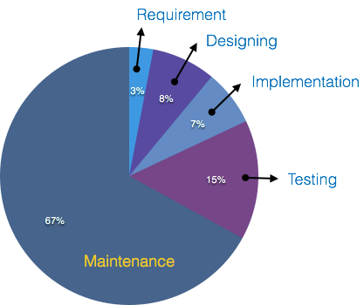
Cost of Maintenance
A study on estimating software maintenance found that the cost of maintenance is as high as 67% of the cost of entire software process cycle.
Real-world factors affecting Maintenance Cost
Standard age of software is considered up to 10 to 15 yrs.
Older software, which were meant to work on slow machines with less memory and storage capacity cannot keep themselves challenging against newly coming enhanced software on modern hardware.
As technology advances, it becomes costly to maintain old SW.
Most maintenance engineers are newbie and use trial and error method to rectify problem.
Changes are often left undocumented which may cause more conflicts in future.

Slide 33
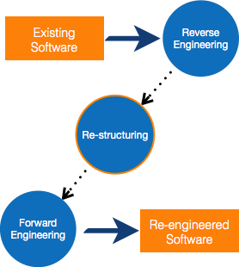
Software Re-engineering
When we need to update the software to keep it to the current market, without impacting its functionality, it is called software re-engineering.
It is a in-depth process where the design of software is changed and programs are re-written.
Re-Engineering Process
Decide what to re-engineer. Is it whole software or a part of it?
Perform Reverse Engineering, in order to obtain specifications of existing software.
Restructure Program if required. For example, changing function-oriented programs into object-oriented programs.
Re-structure data as required.
Apply Forward engineering concepts in order to get re-engineered software.

Slide 34

Reverse Engineering
It is a process to achieve system specification by thoroughly analyzing, understanding the existing system.
An existing system is previously implemented design, about which we know nothing. Designers then do reverse engineering by looking at the code and try to get the design.
With design in hand, they try to conclude the specifications. Thus, going in reverse from code to system specification.

Slide 35
Reuse
Re-use can be done at various levels
Application level - Where an entire application is used as sub-system of new software.
Component level - Where sub-system of an application is used.
Modules level - Where functional modules are re-used.
Software components provide interfaces, which can be used to establish communication among different components.
Reuse Process
Two kinds of method can be adopted: either by keeping requirements same and adjusting components or by keeping components same and modifying requirements.

Slide 36
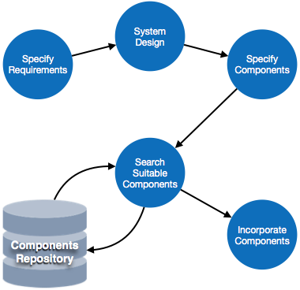
The Reuse Process
Requirement Specification - The functional and non-functional requirements are specified, which a software product must comply to, with the help of existing system, user input or both.
Design - Basic architecture of system as a whole and its sub-systems are created.
Specify Components - By studying the software design, the designers segregate the entire system into smaller components or sub-systems. One complete software design turns into a collection of a huge set of components working together.
Search Suitable Components - The software component repository is referred by designers to search for the matching component, on the basis of functionality and intended software requirements..
Incorporate Components - All matched components are packed together to shape them as complete software.

Slide 37
Thank you

